Slide 1
QA – Automation Tester Certification
Test Automation Engineer – Preparation Course – Session 01

Slide 2
QA – Automation Tester Certification
Content
01. UI Web based application Automation
Selenium Webdriver, BDD Gherkin Language, Specflow, Page Object Model
02. Backend API Rest Automation
GET / POST / PUT / DELETE requests
Postman, ResponsibilityChain pattern
03. UI Android application Automation
Appium, Locators in Android
04. Continuous Integration over Azure Environment
Vstest Executor
Pipelines
Reporting
Selenium Grid

Slide 3

01. UI Web based application Automation
Selenium: How to Start a New Project
SELENIUM
WEBDRIVER & LOCATORS

Slide 4

01. UI Web based application Automation
1.1 Selenium
Selenium is a free (open source) automated testing suite for web applications across different browsers and platforms. Selenium WebDriver sends commands to a browser and retrieves results. Most browser drivers actually launch and access a browser application (such as Firefox, Chrome, Internet Explorer, Safari, or Microsoft Edge).
The WebDriver directly starts a browser instance and controls it. However, Selenium Grid can be used with WebDriver to execute tests on remote systems.

Slide 5
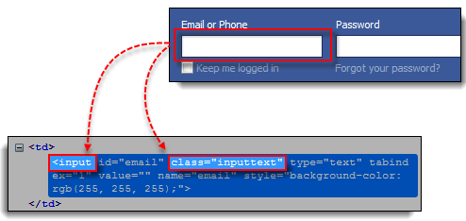
01. UI Web based application Automation
1.2 Selenium Basics: From Zero to Hero
Locator is a command that tells Selenium which GUI elements (Text Box, Buttons, Check Boxes, etc) its needs to operate on. Identification of correct GUI elements is a prerequisite to creating an automation script. But accurate identification of GUI elements is more difficult than it sounds. Sometimes, you end up working with incorrect GUI elements or no elements at all.

Slide 6
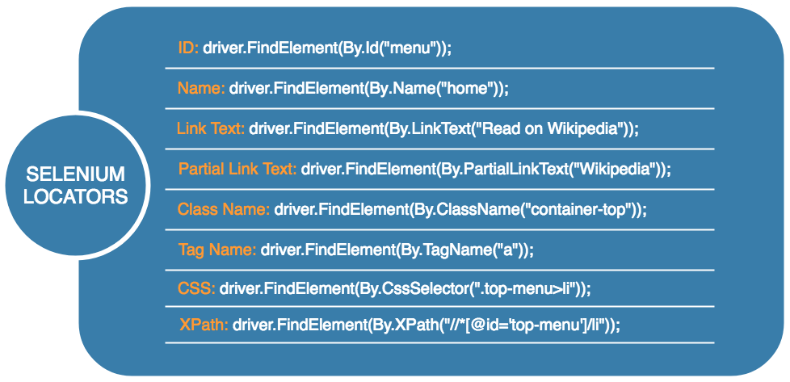
01. UI Web based application Automation
1.2 Selenium Basics: From Zero to Hero

Slide 7
01. UI Web based application Automation
Selenium: How to Start a New Project
PRACTICE
HOW TO START A NEW PROJECT?

Slide 8
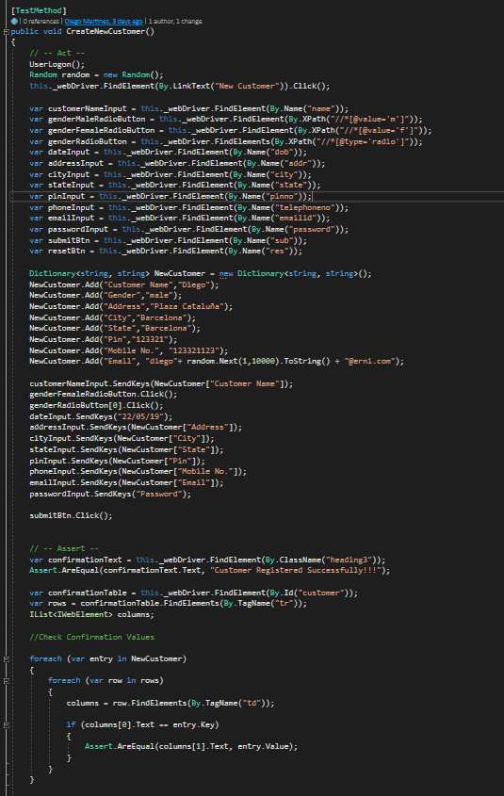

01. UI Web based application Automation
1.3 Practice: How to start a new Project?

Slide 9
01. UI Web based application Automation
Selenium: How to Start a New Project
POM & BDD
PAGE OBJECT MODEL & SPECFLOW

Slide 10
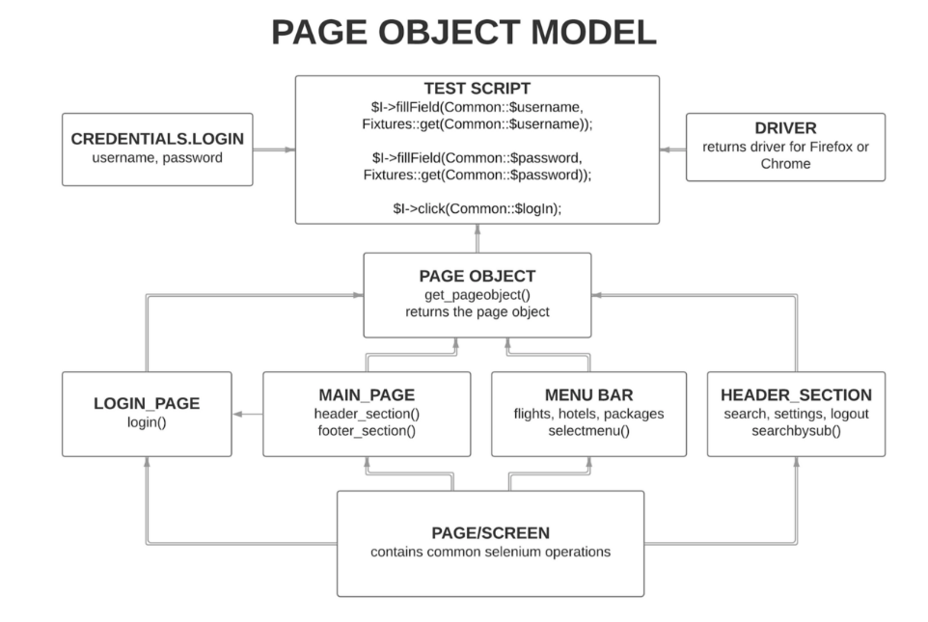
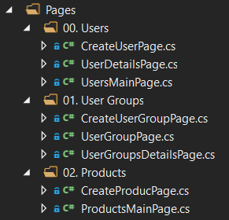
01. UI Web based application Automation
2.1 Page Object Model
Page Object Model is a design pattern to create Object Repository for web UI elements. Under this model, for each web page in the application, there should be corresponding page class. This Page class will find the WebElements of that web page and also contains

Slide 11
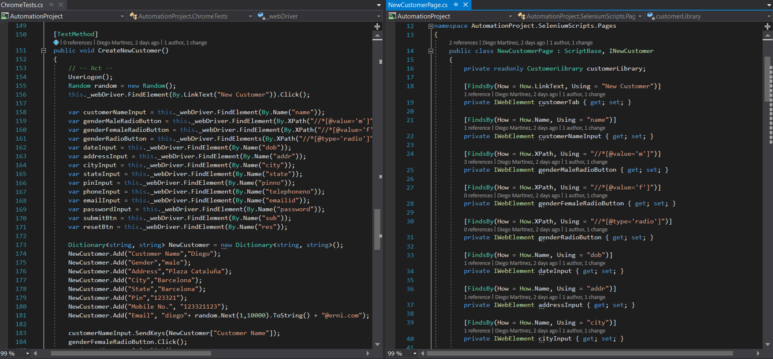
01. UI Web based application Automation
2.1 Page Object Model

Slide 12
01. UI Web based application Automation
2.2 Specflow: Gherkin Language
SpecFlow is used to define, manage and automatically execute human-readable acceptance tests in .NET projects. Writing easily understandable tests is a cornerstone of the BDD paradigm and also helps build up a living documentation of your system.
Gherkin is the language used to define test cases. It is designed to be non-technical and human readable, and collectively describes use cases relating to a software system.
GIVEN
WHEN
THEN
What software will look like to user
Things that the user will do
What the user should expect

Slide 13
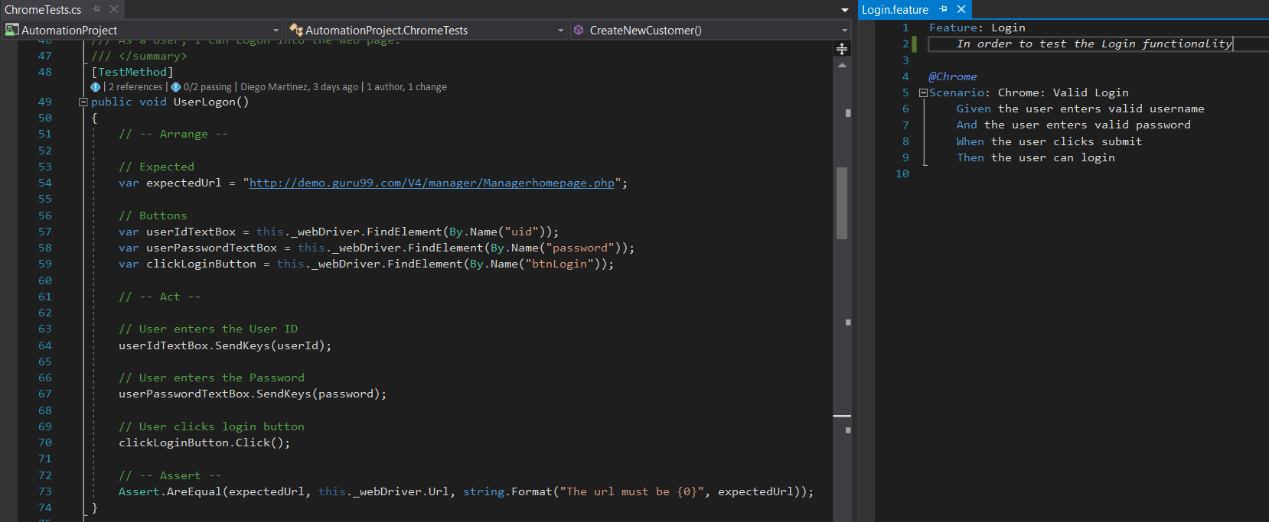
01. UI Web based application Automation
2.2 Specflow: Gherkin Language

Slide 14
01. UI Web based application Automation
Selenium: How to Start a New Project
PRACTICE
USING SPECFLOW & POM

Slide 15

Diego Martínez Gilabert
diegomartinezgilabert@erni-espana.es

